Slide 1
Introduction To Java

Slide 2
JAVA : Intro
object-oriented, cross platform, multi-purpose programming language produced by Sun Microsystems
combination of features of C and C++ with some essential additional concepts.
well suited for both standalone and web application development
designed to provide solutions to most of the problems faced by users of the internet era
Oracle acquired Sun Microsystems in January, 2010. Therefore, Java is now maintained and distributed by Oracle.

Slide 3
JAVA : History
language developed by Sun Microsystems of USA in 1991.
Originally called Oak by James Gosling, one of the inventors of the language
designed for the development of software for consumer electronic devices like TVs, VCRs and such other electronic machines
goal had a strong impact on the development team to make the language simple, portable and highly reliable.
Patrick Naughton discovered that the existing languages like C and C++ had limitations in terms of both reliability and portability
modelled their new language Java on C and C++ but removed a number of features of C and C++ that were considered as sources of problems and thus made Java a really simple, reliable, portable and powerful language

Slide 4
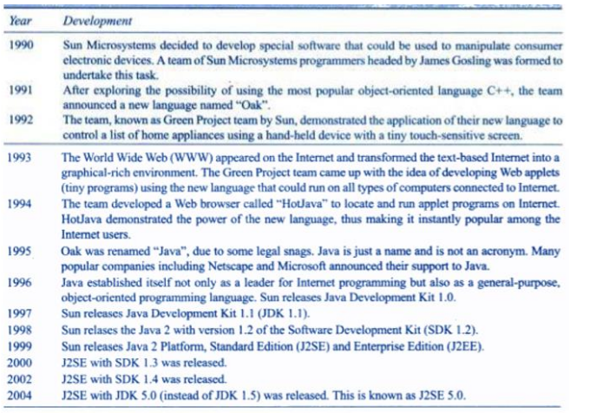
JAVA : Milestones

Slide 5
JAVA : Features
Object Oriented
Java supports the features of object-oriented programming.
Its object model is simple and easy to expand.
Platform indepenent
C and C++ are platform dependency languages hence the application programs written in one Operating system cannot run in any other Operating system, but in platform independence language like Java application programs written in one Operating system can able to run on any Operating system.
Simple
Java has included many features of C / C ++, which makes it easy to understand.
Secure
Java provides a wide range of protection from viruses and malicious programs.
It ensures that there will be no damage and no security will be broken.

Slide 6
Java : Features
Portable
Java provides us the concept of portability.
Running the same program with Java on different platforms is possible.
Robust
During the development of the program, it helps us to find possible mistakes as soon as possible.
Multi threaded
The multithreading programming feature in Java allows you to write a program that performs several different tasks simultaneously.
Distributed
Java is designed for distributed Internet environments as it manages
the TCP/IP protocol.

Slide 7
The internet and JAVA’s place in IT
Earlier Java was only used to design and program small computing devices
later adopted as one of the platform-independent programming languages
according to Sun, 3 billion devices run Java.
Java is one of the most important programming languages in today's IT industries.

Slide 8
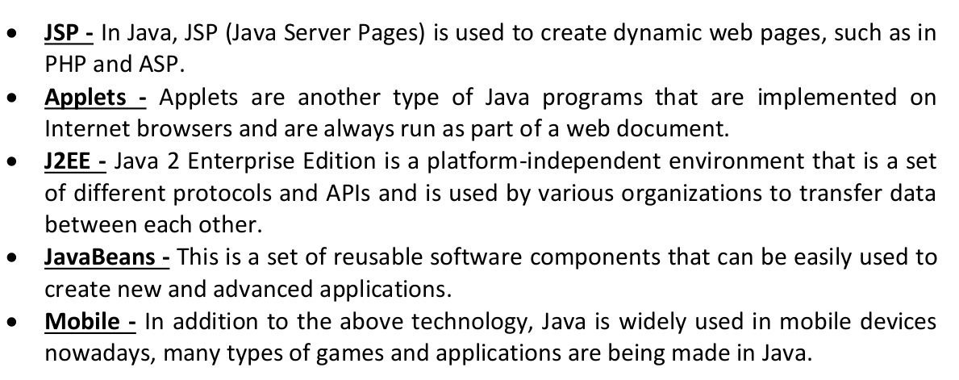
Applications and Applets

Slide 9
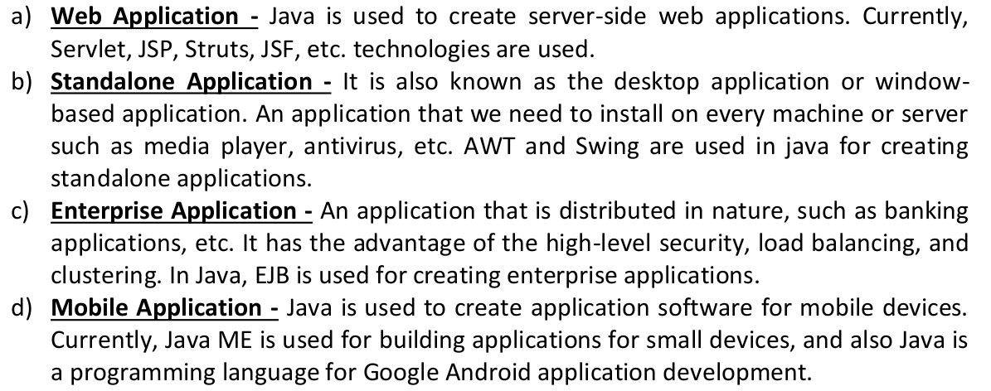
Applications and Applets

Slide 10
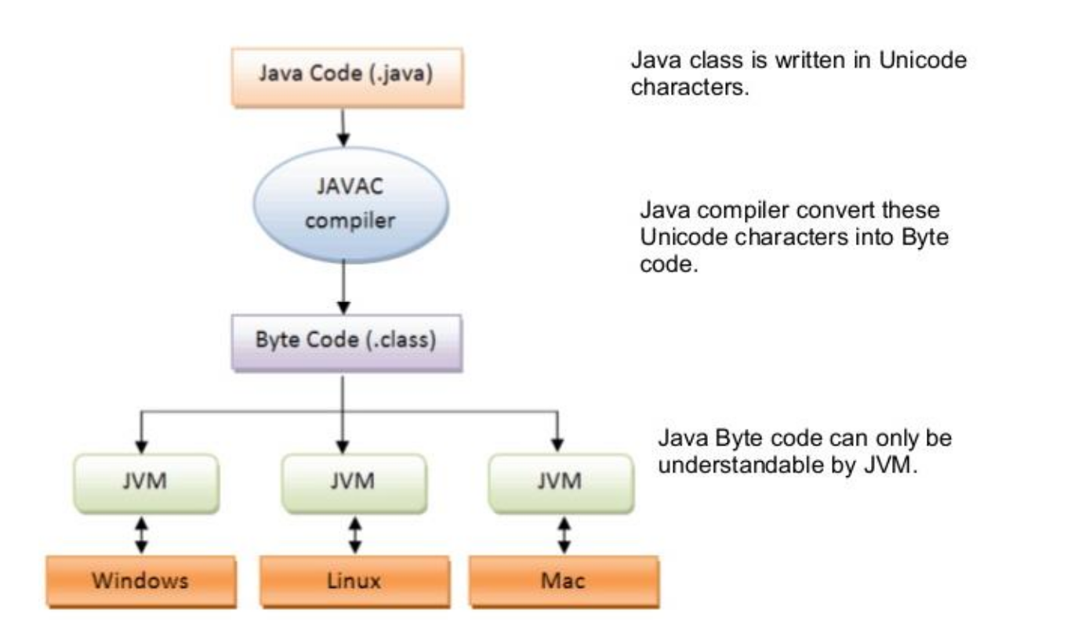
JAVA Virtual Machine (JVM)

Slide 11
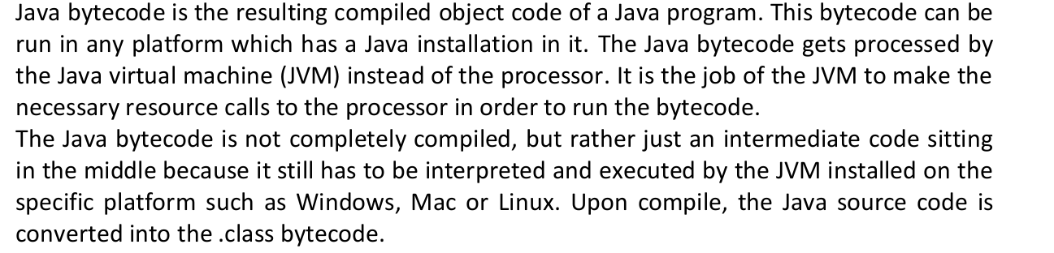
Byte Code : not an executable code

Slide 12
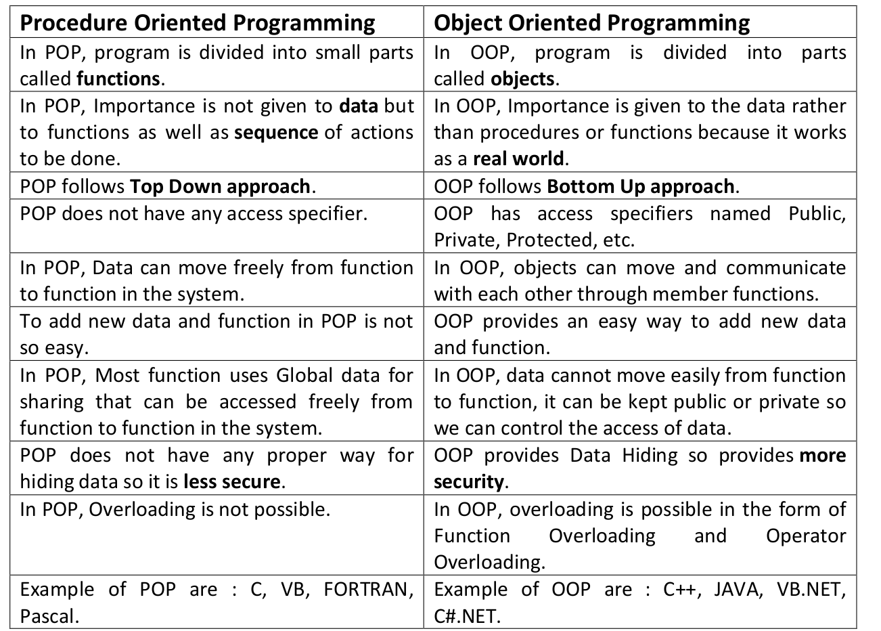
Procedure Oriented vs Object Oriented Programming

Slide 13
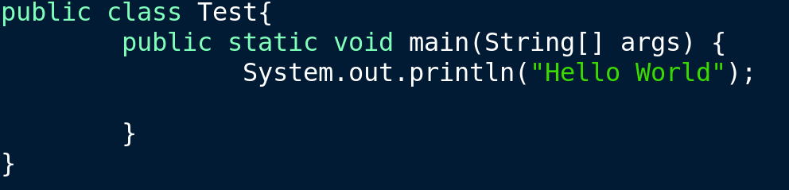
Hello World

Slide 14
Errors
Compile Time : Syntactical
Runtime : Semantical

